Slide 1

Azure SQL Edge
Meeting the demands of IoT edge data & compute - with the world’s #1 data engine
Introduction 101
March 2020

Slide 2
The IoT landscape
Data and compute being pushed to the edge
By 2025, 75% of enterprise-generated data will be created and processed at the Edge, up from less than 20% today.
80B
180ZB
↑29%
Connected IoT devices by 2025
Amount of data from IoT devices by 2025
CAGR of IoT data, 2018 - 2025
Trends affecting this shift include
Latency, security, bandwidth/connectivity requirements push compute needs to the edge
New sensors and chip innovation enable more compute at lower cost at the edge
5G and IoT mesh architecture accelerate distributed computing
Cost inefficiency to store everything in the cloud
Source: Gartner” “Edge Computing Solutions for Industrial IoT, July 2018, Gartner” “Top Strategic IoT Trends and Technologies Through 2023. September 2018, Gartner
Notes:
The Internet of Things, or IoT, refers to the billions of physical devices around the world that are now connected to the internet, all collecting and sharing data. Thanks to the arrival of super-cheap computer chips and the availability of wireless networks, it's possible to turn anything, from something as small as a button to something as big as an aeroplane, into an IoT device. Connecting up all these different objects and adding sensors to them adds a level of digital intelligence to devices. By collecting and mining data generated by devices at the network periphery, or edge, IoT holds the potential to increase businesses’ profits and improve customers’ lives.

Slide 3
Challenges faced in the IoT driven Data landscape
Network and Infrastructure
Bandwidth
Latency
Data
Volume
Security
Cost
Real – time Needs
Scale & Performance
availability
Notes:
However, when we look at the 180ZB of data that these devices can collect, we realise that there could be challenges in this IoT drive data landscape.
These challenges are 2 fold
one being Network and INfrastructure
and the second being the data that is collected
Let us look at network. IoT devices are heavily dependent on network but network availbaility varies across the globe
Low bandwidth , high latency, low network availability and High costs al play a crucial role here. While 5G is aimed at solving some of these problems, it will not be addressed globally. For example, let us take a ship sailing in the middle of the pacific. There are huge stretches without internet and the only internet that would be available is the expennsive Satllite internet which is not reliable
When it comes to data, there is a need to process it at the origin for quick decision making. WIth the increaisng colume, tranmitting data constanly is expensive. Added to that there is a layer of complexity when it comes to storage and security of the data

Slide 4
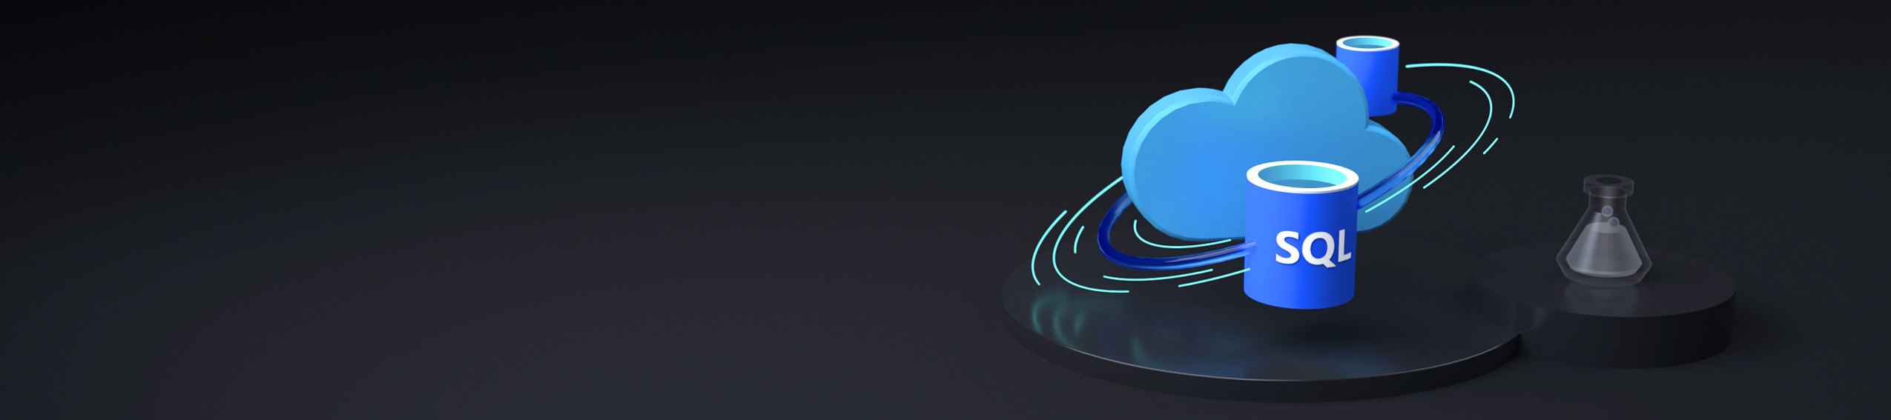
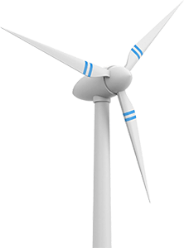
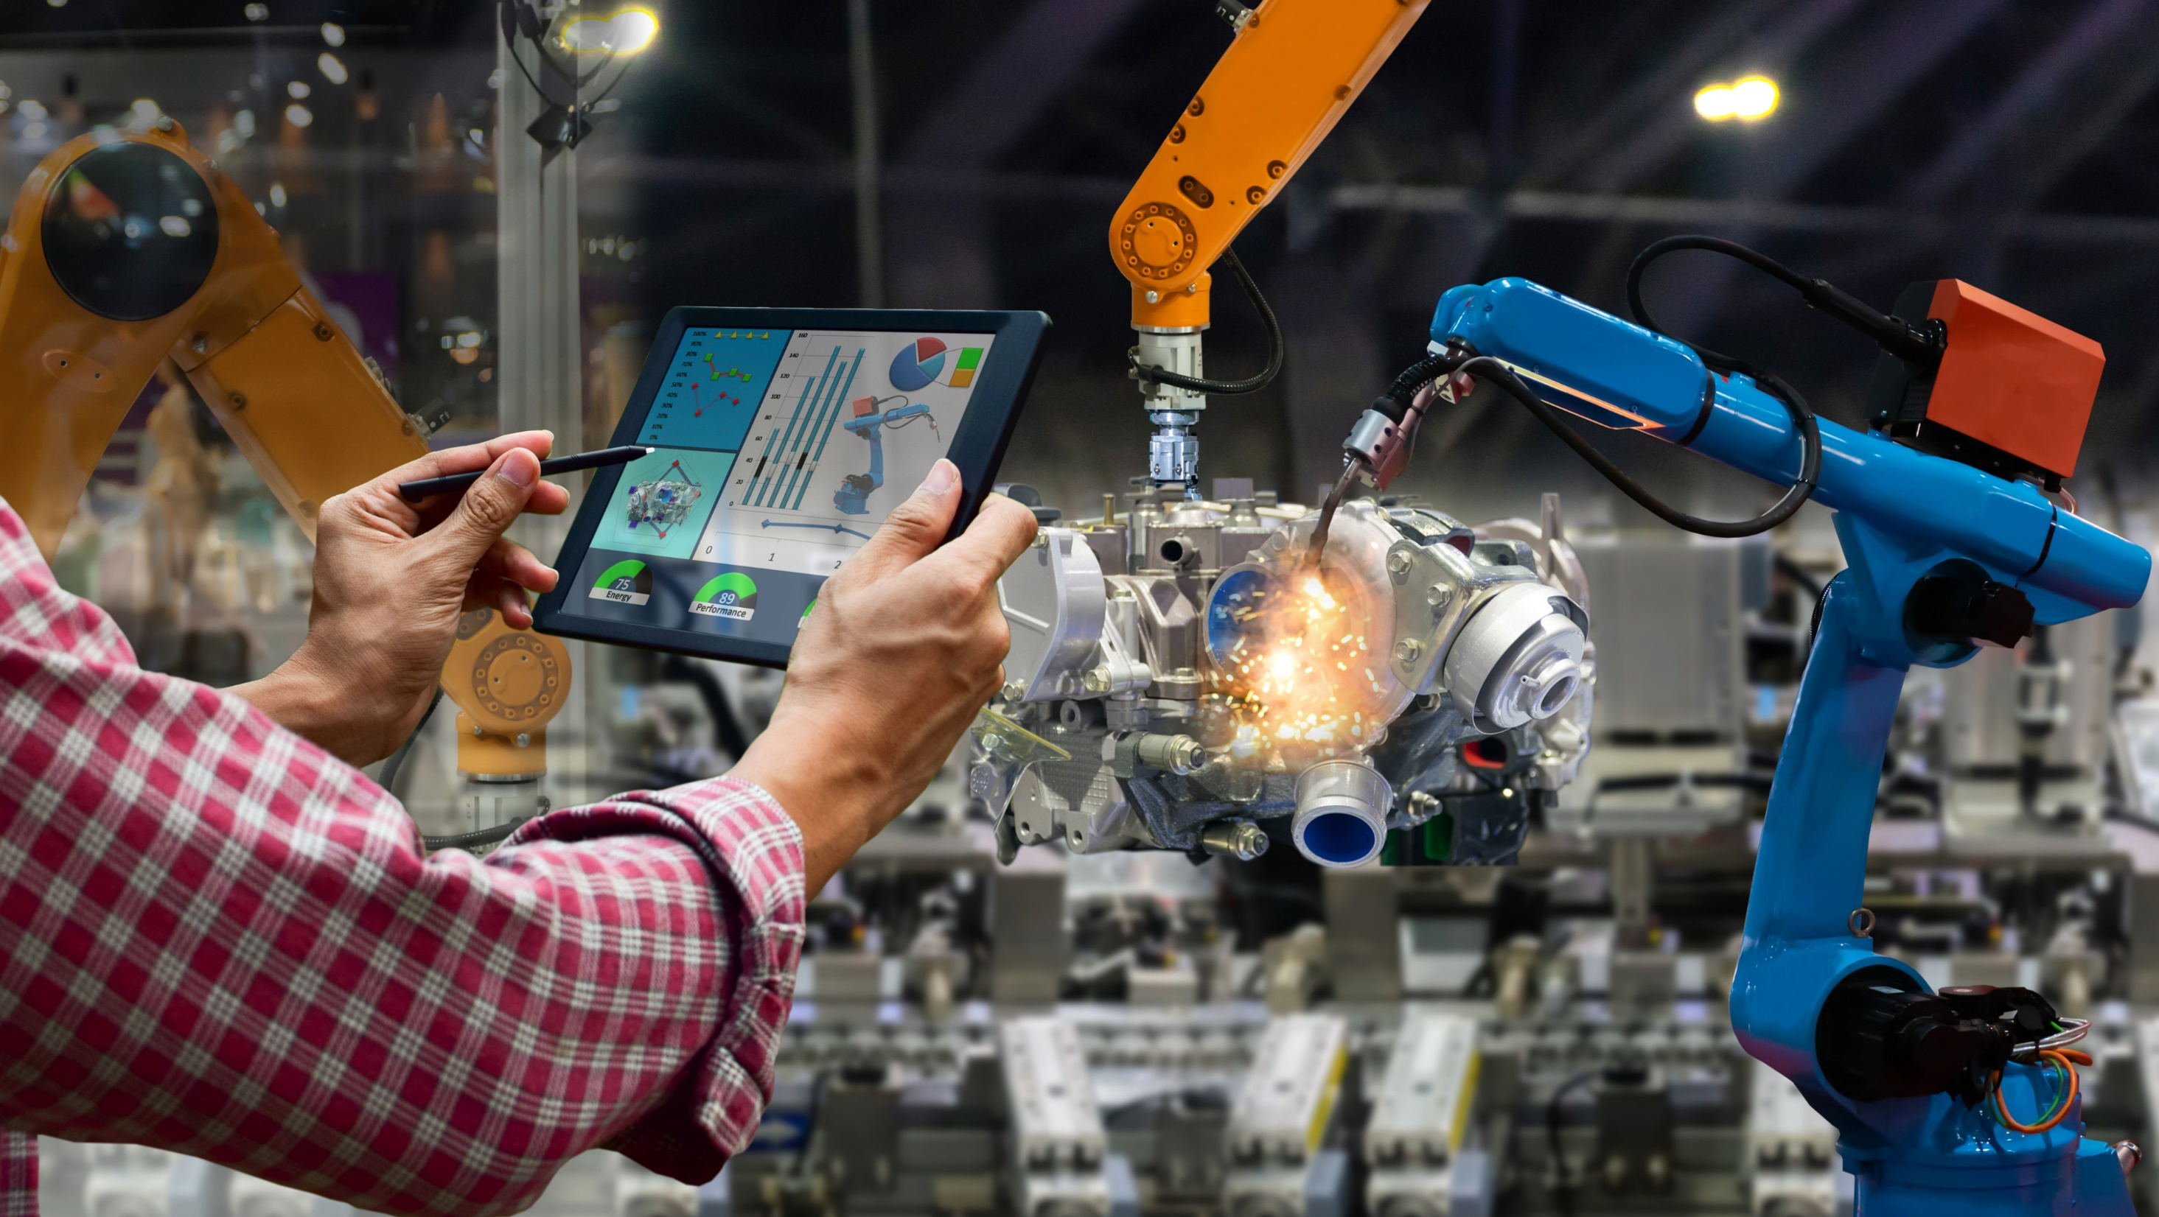
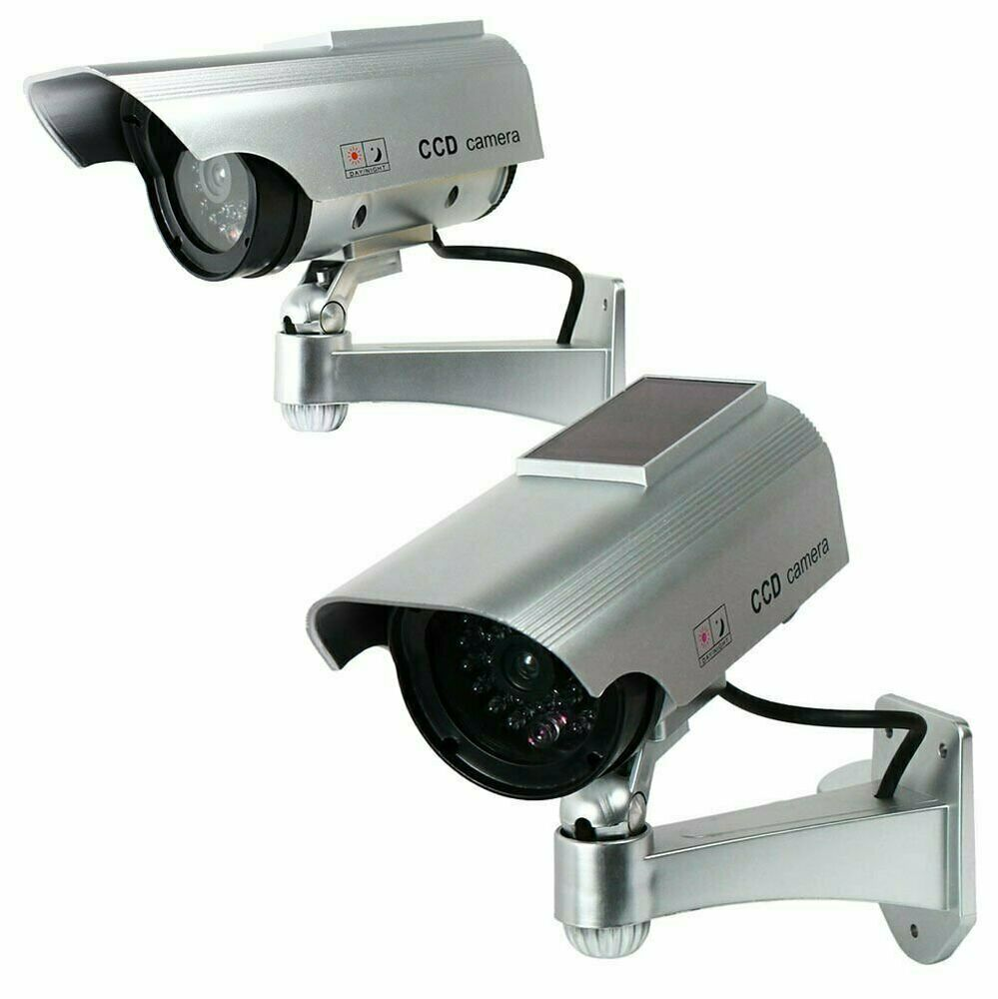
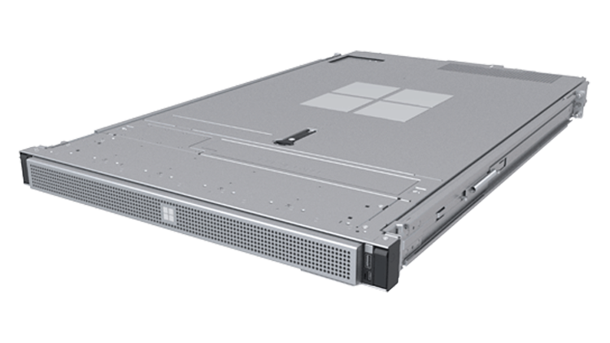
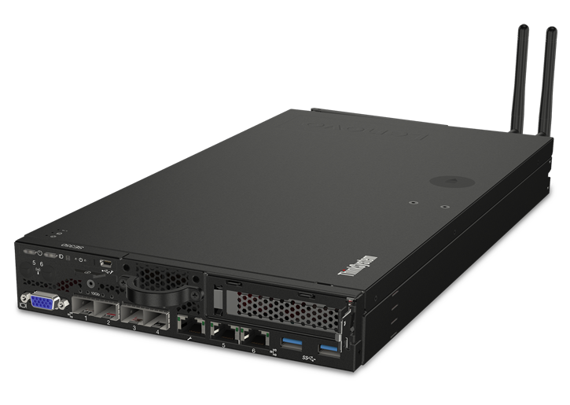
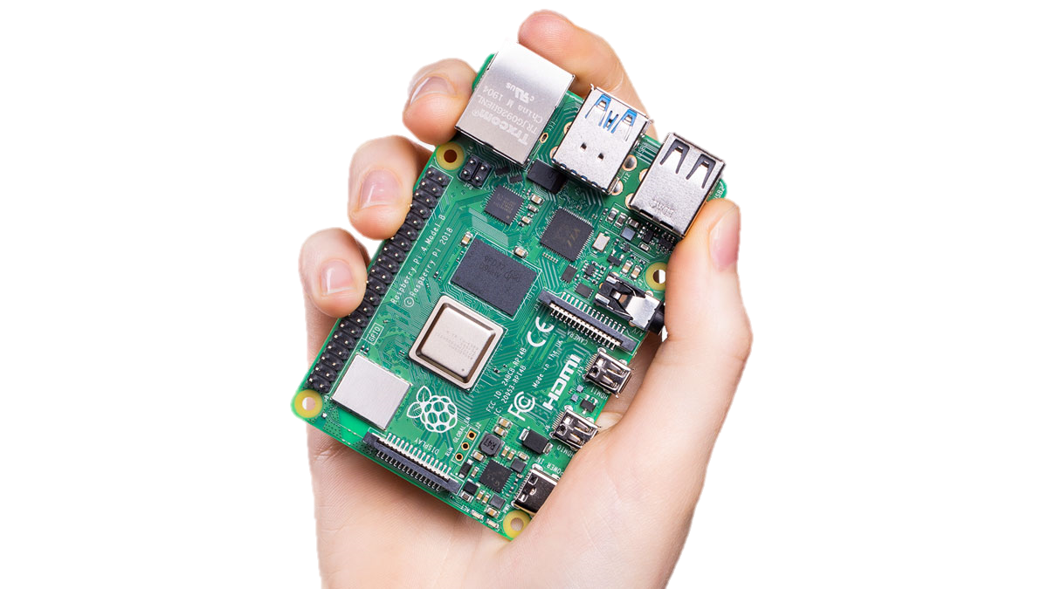

Azure SQL Edge
Meeting the demands of IoT edge data & compute - with the world’s #1 data engine
Data
Centers
Edge
Servers
Edge
Gateways
IoT
Devices
Intelligent Cloud
Intelligent Edge
18%*
36%*
32%*
Azure SQL
SQL Server
Upper Boundary
16 core (3p HW)
No limit (1p HW)
Lower Boundary
1 core
1 GB memory
Azure Sphere
Develop once, deploy anywhere.
Extends the #1 data engine to IoT edge & ARM devices
Built, optimized, & priced specifically for IoT
No upskilling or retraining needed for SQL customers
Connected, disconnected, & semi-connected scenarios
All images for example purposes only.
SQL Database Edge Early Adopter Program Survey, 1/9/20, “What device types will you use for the Azure SQL DB Edge solution. Please select all device types that apply.” Other/Don’t Know 14%
Notes:
Azure SQL Edge is one step closer towards solving these challenges. It is a database optimized for IoT. Built using teh same SQL Engine that is present on SQL Server and Azure SQL offerings it provides the same industry leading security and performance. It also provides the same developer and tooling experience you always know and trust.
Azure SQL Edge can run on devices that have a minimum of 1 core ranging from IoT devices to Edge Servers
Further, Azure SQL Edge supports connected, disconnected and hybrid scenarios

Slide 5





Azure SQL Edge
Edge optimized IoT Database with built-in streaming, storage and AI
Data streaming
built-in
Time-series
built-in
Native data movement to Azure
ML & analytics
built-in
#1 DB in
performance & security
Easy-to-use, low-latency, real-time analytics with Azure Stream Analytics
Stream, store, and analyze data using time-windowing, aggregation, & filtering
Consistent app development & management from cloud to data center to edge.
Detect anomalies and apply business logic using the built-in ML capabilities.
Flexible high availability & disaster recovery. Industry-leading data protection & security tools.
DEVELOP ONCE
DEPLOY ANYWHERE
Consistent application development and management experience
Simplify your architecture from ground to cloud to edge
Azure SQL
SQL Server
Azure SQL Edge
Product Page
Case Study: ZEISS
Demo
Documentation
Notes:
Azure SQL Edge introduce a couple of new features.
Azure SQL Edge is a fully containerized solution compatible with most docker container engines. It can run not only on Intel/AMD devices but also on ARM 64 devices.
SQL Edge includes native support for data streaming, to and from multiple input and output targets, this is the same engine that powers Azure Stream Analytics.
Time Series Processing is another new feature added to Azure SQL Edge. This comprises of - Time series capabilities already existing in Azure Stream Analytics such as anomaly detection, and we have also designed T-SQL functions and syntax to query time series data.
SQL Edge also has ML inferencing capabilities. ML Models can be trained in the cloud / on premises and deployed to the edge where inferencing can be done on data that is being collected.
There is also Native data movement which ensure seamless integration to Azure and make use of the rich ecosystem of data products made available to customer.. This ensure consistent app development and management from cloud to the edge
Finally when it comes to Security features, we have Data Encryption , Classification and access controls.

Slide 6




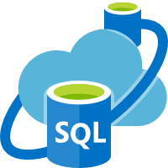





Azure SQL Edge
Reference Architecture - Connected
Cosmos DB
Storage (Azure)
Azure Synapse Analytics
Edge Hub
Azure SQL Edge
Data Movement ASA & ADF
ADLS Gen 2
Azure ML
Portal
Azure SQL
Notes:
Now that we have spoken about Azure SQL Edge and its features, let us take a look at this reference architecture.
Millions of messages are genrated by the IoT devices and sensos installed in the devices. If you look at the architecture here, you will realise that the goal of Azure SQL Edge is to capture and analyse these messages/data. Azure SQL Edge is a containerized application which runs the same SQL Engine that you would see in other Azure SQL services or on a SQL server. The streaming engine that you see here is similar to Azure Stream Analytics and helps us with tasks such as anomaly detection. windowing aggregation etc playing a key role in Azure SQL Edge's time series capabilities.
The trained ML models that are deployed to teh Azure SQL edge instance will monitor functioning of componenets in either a connected or disconnected state.
Finally, data can be moved to Azure for long term storage and further processing. From storage services, data can be sent to Azure Machine Learning for retraining of models. These updated models can then be sent back to Azure SQL Edge to improve ML performance for the IoT application.
From storage services, business analysts can use Power BI to analyze warehoused data.
Web, mobile, and other applications can be built on the serving layer as well. For example, you can expose APIs based on the storage data for third-party uses.

Slide 7

Azure SQL Edge
Reference Architecture - Disconnected
Kafka
Azure SQL Edge
Visualization/ Analytics

Slide 8
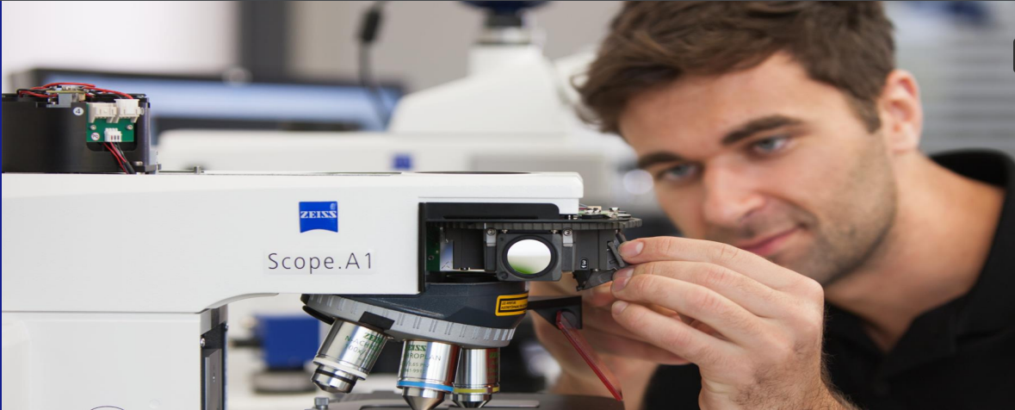
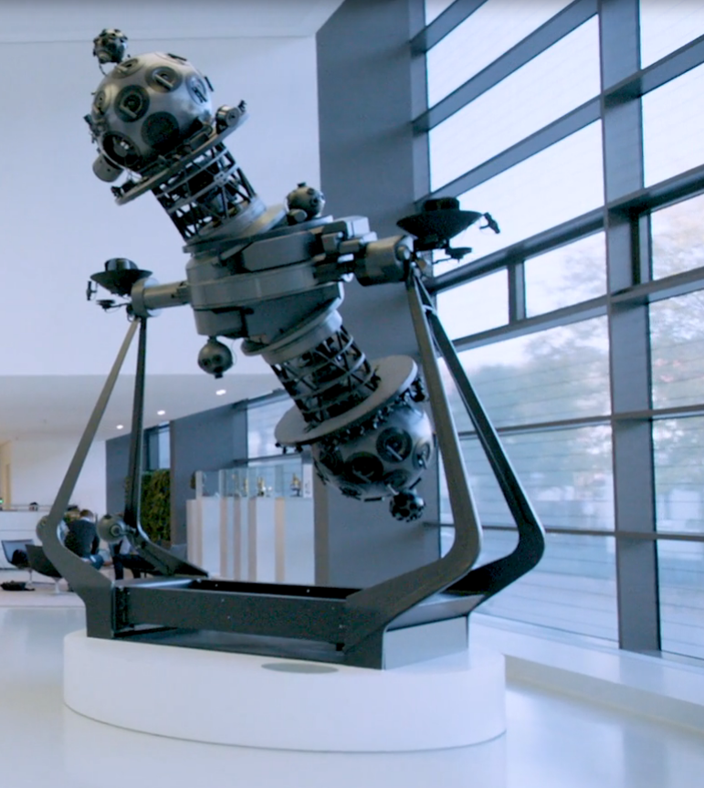
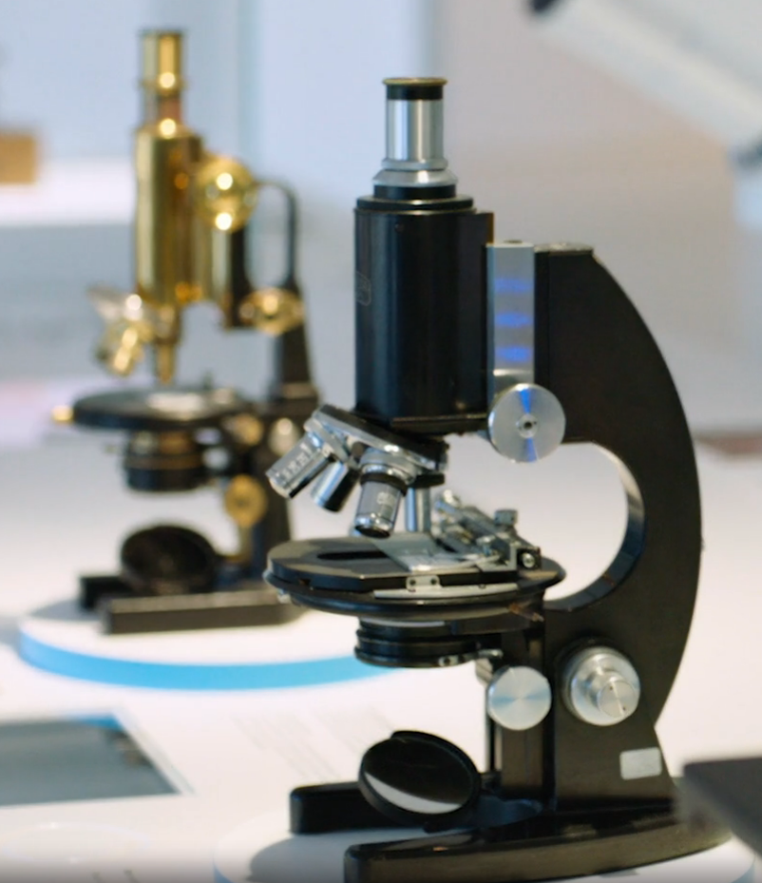
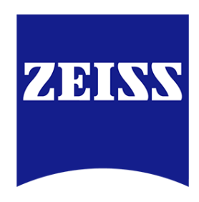


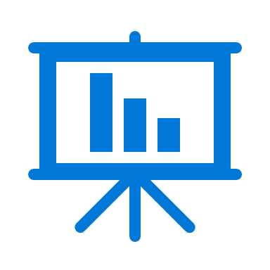
An Azure SQL Edge case study
CHALLENGE
Unable to drive decisions where the data is produced
SOLUTIONS
Allows real-time quality control
Enables A-B testing if required
Gives an ability to push decision making to the edge
RESULT
Factory Floor
Maintenance
Quality Control
“
Anomaly Detection
Real-time actions
Before edge computing, by the time cloud analysis noted a problem, we had lost response time and sometimes wasted product. With SQL Database Edge, we reduce both our reaction time and the number of cycles needed.
“
Notes:
ZEISS is a leading technology enterprise in the fields of optics. They added Microsoft Azure SQL Edge and edge computing devices to their production machines to increase efficiency. Manufacturing optics requires incredible precision—even the smallest aberration can result in a distorted image. In photography, this can lead to a blurry picture. In a medical or imaging device, the stakes are much higher.
ZEISS embarked on a digitization process with the goal of creating a connected smart factory to improve efficiency and accuracy. For example, consider a worker who uses a machine to shape a piece of glass into a lens through “rubbing.” After each minute of rubbing, the worker takes a measurement—up to 20 times in the manufacturing process. If ZEISS had the ability to inspect the glass much earlier and faster, this could reduce the number of inspections down to one, which would save time and worker capacity.
ZEISS added IoT devices running SQL Edge for more accurate, faster analytics of sensors that track temperature, humidity, and other conditions. For ZEISS, IoT is critical for delivering the data transparency that enables technicians to instantly understand the state of each machine at a specific point in time, and even to predict future conditions. Now the ZEISS production floor can take advantage of in-database machine learning for immediate scoring, initiating corrective actions and detecting anomalies. The edge devices analyze the data batch, notify technicians of any necessary corrective actions, and then upload the batch to ZEISS’s Azure Data Lake.
If Zeiss produced 10 microscopes per day, SQL Edge helps us understand how to use the same resources to deliver 12 microscopes at the same quality.

Slide 9
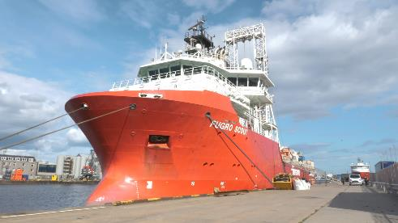
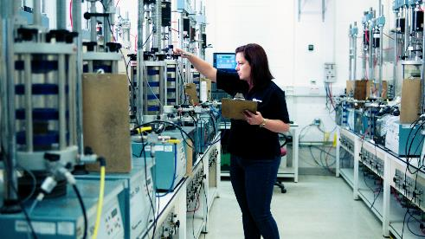
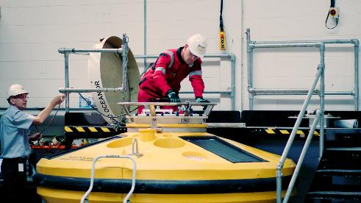






An Azure SQL Edge case study
CHALLENGES
Unable to drive real-time insights
Need to store exploration data on the ship which could span 100s of GBs
Analytics happens only when ship returns
SOLUTIONS
Enables analytics while at sea without network connectivity
Ability to develop once and deploy anywhere
Ability to use a consistent model for centralized analytics in the cloud
RESULTS
Operational data in Azure SQL Database
Azure ML
Azure SQL Database
On-Prem
Cloud
Sensitive data
Predictions & other data
Trained ML
Ship & buoy
remote data collection
Edge
Maintenance
“
Insights
Reports that once took two weeks to compile now take eight minutes. This is a game changer. It massively simplifies everything we do.
Azure SQL Edge
“
Data Streaming
Anomaly Detection
Real-time Action
Notes:
Fugro is a geo-intelligence provider that helps clients in the energy sector gain vital insights for marine projects. To support its clients in early projects phases, Fugro sends a team of oceanographers, meteorologists, to collect environmental data such as water depth, wind, waves, currents, and temperature. This data, which iscollected through sensors on ships. Until recently, the marine data that Fugro collected offshore was made available via a satellite link to the rest of the Fugroteam, which is based at the company office on dry land. This data acquired over satellite was then imported into Microsoft SQL Server on premises. Finally, the Fugro team would run analytics on the collected data to derive insights that would help their clients produce cost-effective, sustainable designs for their energy projects.
As you can see there were multiple challenges Fugro faced here
1. They were unable to run real time insights
Most of the anlaytics happened only after the ship had reached the coast
The had to store exploration data on teh ship which went to 100s of GB
The company set out to fix these problems by moving analytics to the cloud and network edge. First,
the Fugro team migrated its on-premises SQL Server environment to Azure SQL Database
in the cloud. Then, the team devised a new process in which Azure IoT Edge and Azure SQL Edge
would be deployed locally at the offshore project site on unmanned vessels.
Owing to Azure SQL Edge, the team is now able to be ingest, query, store, and
process time series data locally at the edge, saving the company significant time and costs associated with latency
and bandwidth usage.

Slide 10
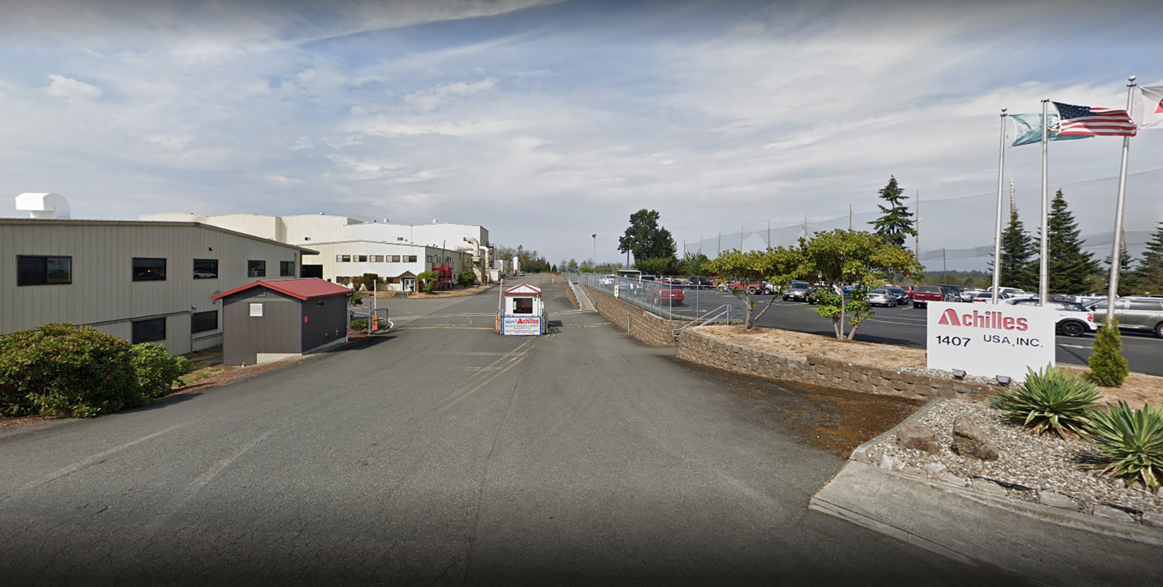
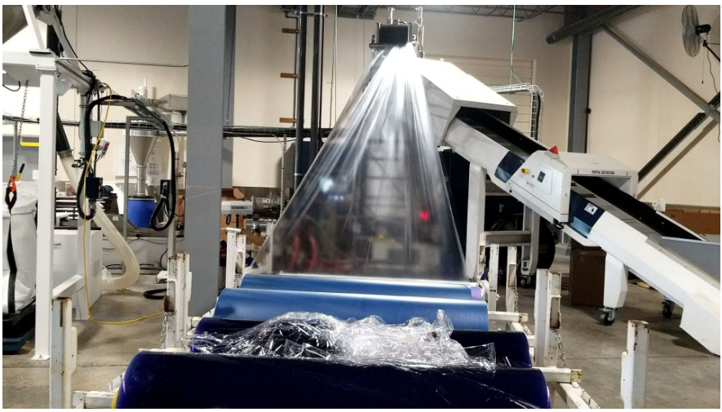
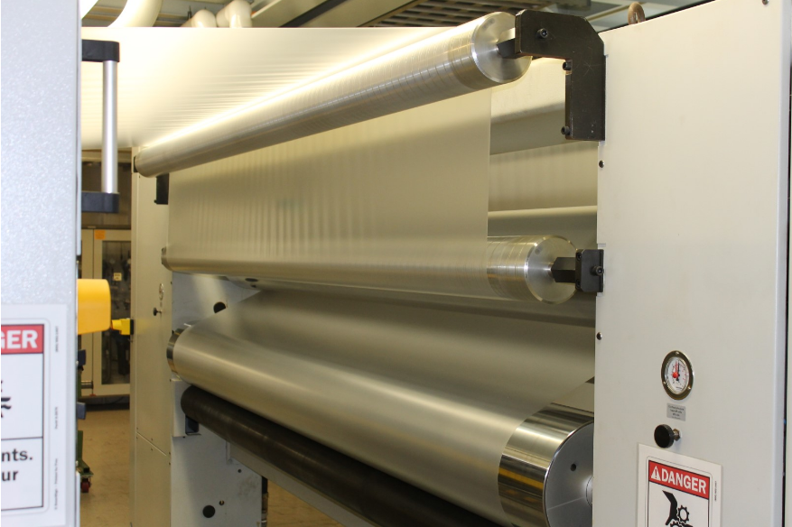

An Azure SQL Edge case study
CHALLENGES
Leading plastic film manufacturer Achilles needed a bidirectional system that could feed setup information for custom jobs to the shop floor and receive equipment setting data for analysis and compliance.
System availability needed to match the factory’s high uptime requirement
SOLUTIONS
Achilles found a way to link devices on the shop floor with its on-premises Microsoft SQL Server databases.
With Azure SQL Edge acting as an IoT device, a staff developer created an app that seamlessly connects the shop floor to the engineers.
RESULTS
“
We’re using Azure SQL Edge in an innovative way. Rather than acting as an IoT device, it runs on Windows as a local database. Even in this different configuration, it runs flawlessly.
“
Notes:
Achilles , a leading plastic film manufacturer, was looking to improve the efficiency of their factory processes - improve data analysis and standardize employee production. Precision is very important for Achilles. They envisioned a sysetem that gave crew's accesss to the latest procedures for every production run.
Using Azure SQL Edge, their IT team developed the Achilles Shop Floor Data Collection system, which provides crews with both an easily updated digital handbook for setting up every job and an onsite data collection mechanism.
The company loads the digital handbooks on its Microsoft SQL Server, and that data is transmited to handheld devices on the shop floor for up-to-the-minute guidance for every job. The crews use Surface devices deployed on the shop floor that run the Shop Floor Data Collection system and Azure SQL Edge. The devices display the digital handbooks for each job for easy reference, and crews update them periodically to document machine settings, which then syncs back to the company’s on-premises SQL Servers.
This production data—which once languished in a file cabinet—is now providing value. Along with providing guidance for the crews running the shop floor equipment, they’re collecting values about shop floor conditions and machine settings that enhance quality. All of that feeds back into product design and manufacturing process standards to give them control they’ve never had before.

Slide 11
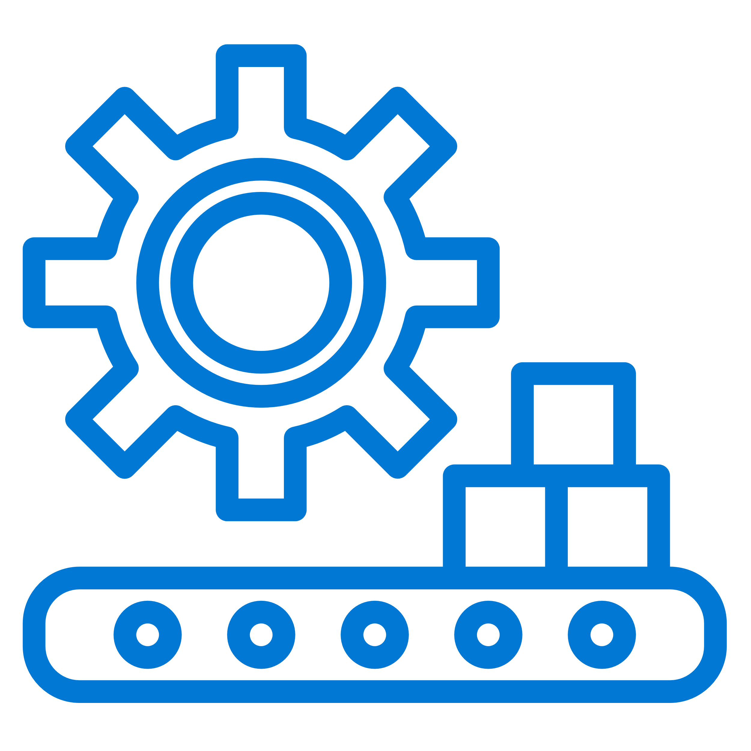




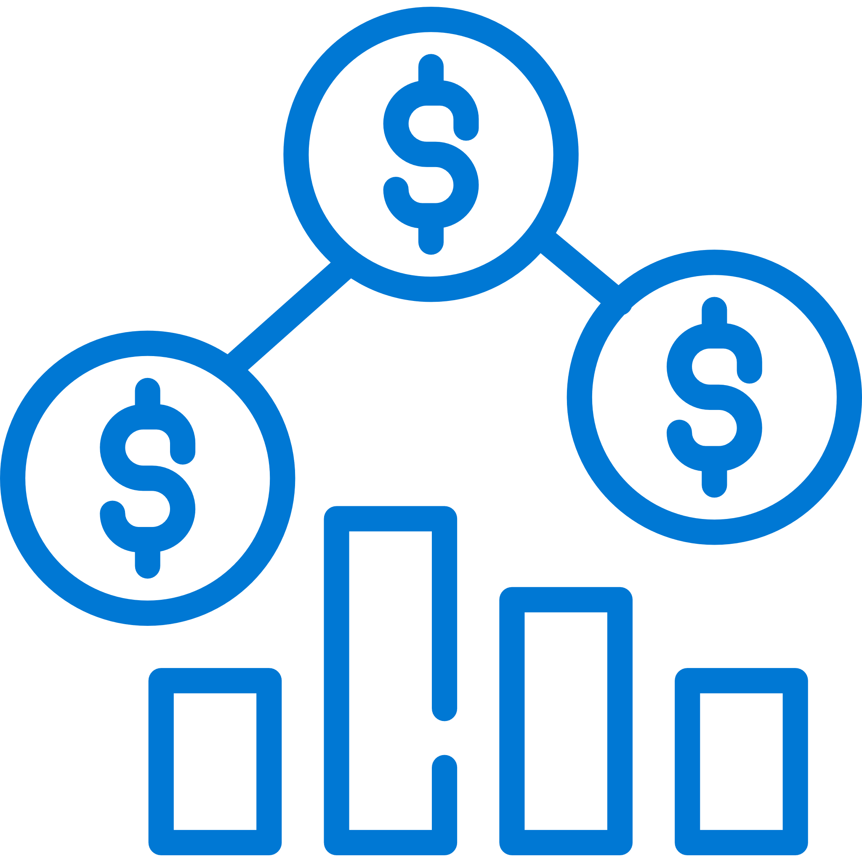



Azure SQL Edge use cases
Holistic view of disparate data sources and devices
MANUFACTURING Smart Factory of the future Predicting human/machine failure on plant floor Process, workflow, asset tracking and inventory | HEALTH CARE Total view of my patient - Analyzing data sources from medical and patient devices Monitoring surgeries and procedures to see how and why mistakes were made US doctors monitoring patient EKGs located around the world | AEROSPACE Tracking health and location of all assets (planes, people) and integrating with data from digital globe Identifying or predicting machine/part failure
DEFENSE Tracking and monitoring air, sea and land vehicles and defense equipment Analyzing drone and satellite data | AUTOMOTIVE Smart and autonomous vehicles storing and analyzing data for real-time decision-making | FINANCIAL Financial process optimization and risk mitigation Asset tracking and auditing
OIL & GAS Monitoring offshore oil rigs to predict failures, improve efficiencies, and lower risk | RETAIL Onsite inventory system for retailers | SMART BUILDINGS & HOMES Accessing data from cameras and numerous sensors to analyze, manage, secure, and control building
11

Slide 12
Demo
Leveraging Azure SQL Edge in a windfarm
Notes:
For the purpose of this demo let us assume that we are the operators on the Contoso wind farm.
We have a dashboard which represents the turbines on the windfarm, The central unit of each of these turbines has an azure sql edge instance running on each of it. The edge instance is actually collecting data from multiple sensors located in the different components/parts of the wind turbine. The sensors measure various aspects that could affect the wind turbine wind speed, wind direction and oil temperature
Additionally data from each of these sensors is streamed to the ASE for processing and inferencing.
Data from each of these instances is aggregated and uploaded to a cloud target. in this case teh cloud target is Azure Blob Storage. This is for essential for long term retention and ML model training.
An issue has been identified on Unit 34. Let us see what is wrong with it.
Power generation is falling but there are no issues with vibration or oil temperature.
You will notice no information is being displayed in the security panel. As we are windfarm operators and not security engineers we do not see any information on this panel. This is because we are using teh inherent SQL security feature - role based access control.
When you look at the wind speed and win direction of the farm it is pretty stable it doesnt change over a period of time. But if you look at the wind speed and wind direction of the turbine you will notice a lot of turbulence and teh deviation experienced by the turbine is high.
First we are setting up our Azure ML workspace to train our ML model to correct the wake adaptation of the turbine
As you can see here, we are fetching data from Azure Blob Storage. Data from each of the SQL Edge instances are being written to blob storage for ML model training. This is what we are reading here
Once the data is loaded we will create a subset to visualize the data and to check if we have enough data points for model training. We have 8k record which is good enough
The std dev in the wind speed is high you will get Atblade values as true . so we need to alter the blades. Same is with the Wind speed.
We are going to create a ML experiment and run it. However, as this will take time -> we will use an already run experiment.

Slide 13
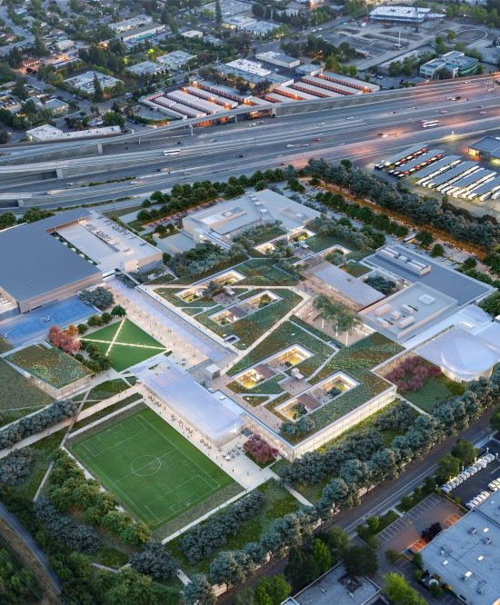
Additional Resources
Learn more about Azure SQL Edge at http://aka.ms/sqledge
Building E2E IoT solutions with SQL Edge
Features and Capabilities
Azure SQL Edge Whitepaper
Azure SQL Edge Customer Stories
Fugro
Zeiss
Learn more about Microsoft industry solutions at microsoft.com/utilities
Our perspectives in blogs, videos and articles
Customer stories
Events & webcasts
Social channels
Notes:
Azure SQL Edge simplifies edge architecture and IoT application development for customers by supplying a smallfootprint data engine that runs on a choice of platforms and delivers consistency in data, tooling, and security from edge to cloud. Powerful enough to run offline, but with the capability to connect seamlessly to a broader network of services, Azure SQL Edge includes built-in AI capabilities, support for time-series data, and native data synchronization with SQL Server and Azure services such as SQL Database. With Azure SQL Edge, customers have a small but powerful data engine that meets the challenges of IoT, which empowers businesses to use and analyze data collected at the network edge to save costs, drive innovation, improve safety, and gain competitive advantage.

